Slide 1
Adaptive Indoor Localization with Wi-Fi Based on Transfer Learning
Anmin Hu, Lijun Zhang School of Electronics and Information Engineering Beijing Jiaotong University Beijing, China {17125027,ljzhang}@bjtu.edu.cn

Slide 2
Contents
1
Background
2
Challenge
3
Solution
4
Experiment

Slide 3
1
Background

Slide 4
Background
In recent years, with the rapid development of mobile Internet and the rapid spread of smart phone terminals, location-based services (LBS) have brought great convenience to people in social production and life.
Satellite navigation cannot be used indoors due to the rapid attenuation of GPS navigation signals through the wall. Therefore, various methods and techniques for indoor positioning have been successively released..
Among the many positioning technologies, RF fingerprint technology has the characteristics of high precision and low cost, which attracts more and more researchers.

Slide 5
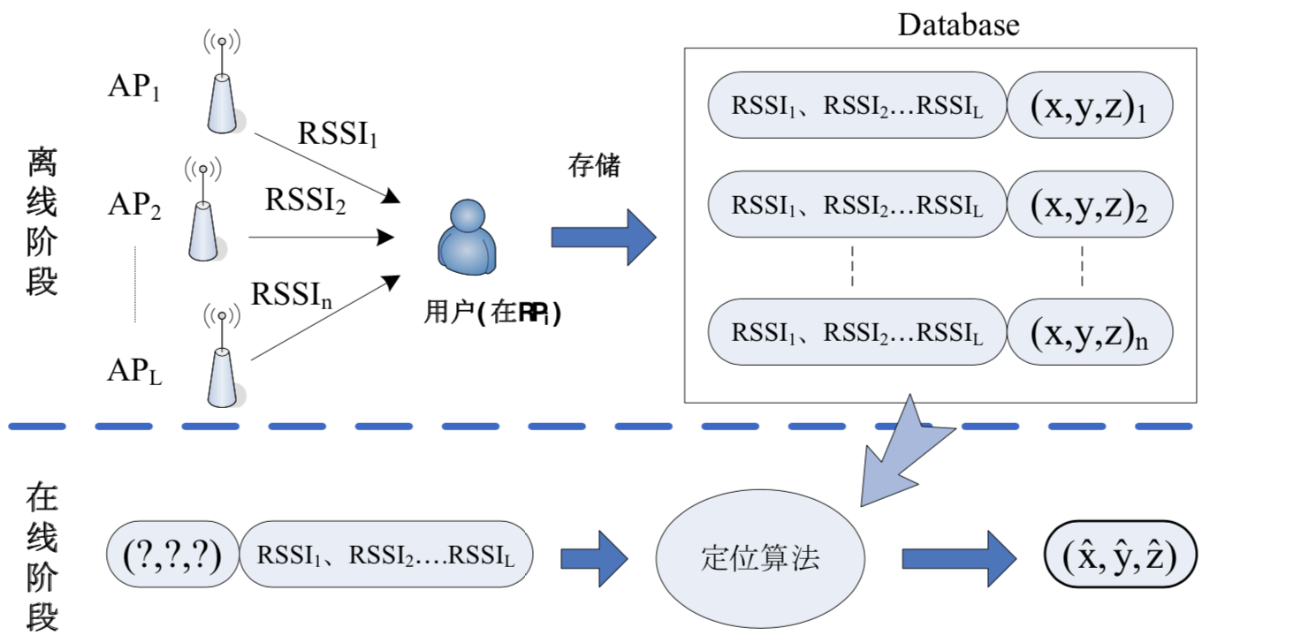
Background
WLAN radio indoor positioning: collect fingerprint database in the offline phase, use machine learning algorithm to learn the nonlinear relationship between WLAN fingerprint vector and position coordinates,
In the online determine the position according to the collected WLAN fingerprint and the learned nonlinear relationship in the online phase;
Fig.1 Signals detected by an IBM R60 at different time periods.

Slide 6
2
Challenge

Slide 7
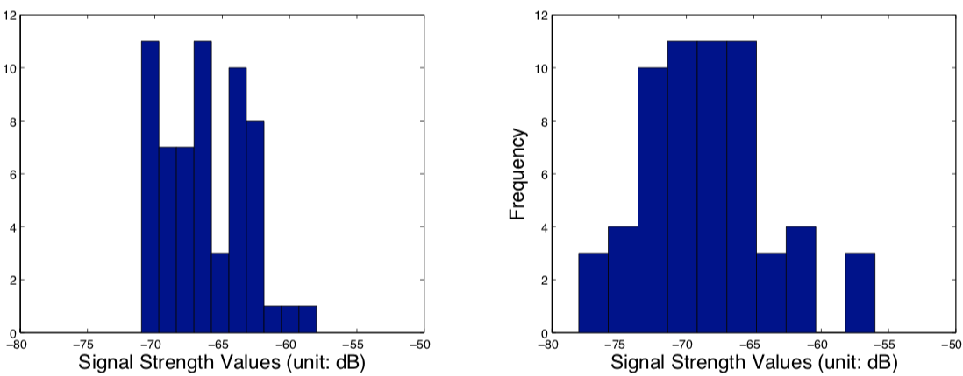
Challenge
Many approaches used in The Wi-Fi based indoor location system (WILS) typically assume the distribution of the signal strength data is time invariant.
However, the assumption does not hold in real world, which degrades the location accuracy.
Fig.1 Signals detected by an IBM R60 at different time periods.

Slide 8
3
Solution

Slide 9
Solution
We propose an algorithm that can adjust the distribution of training data by mixing a fraction of new data.
When environment changes, some instances of $X_{T0}$ become out of date, thus causing the old localization inaccurate. We can select part of data from $X_{T0}$ that have similar distribution to $X_{T1}$ by adjusting the weights of instances.

Slide 10
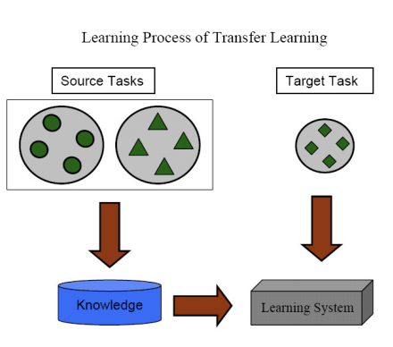
Solution
Transfer learning is proposed to deal with the problem introduced by the training data from source domain and test data from target domain in different feature spaces.
Fig.2 Transfer learning

Slide 11
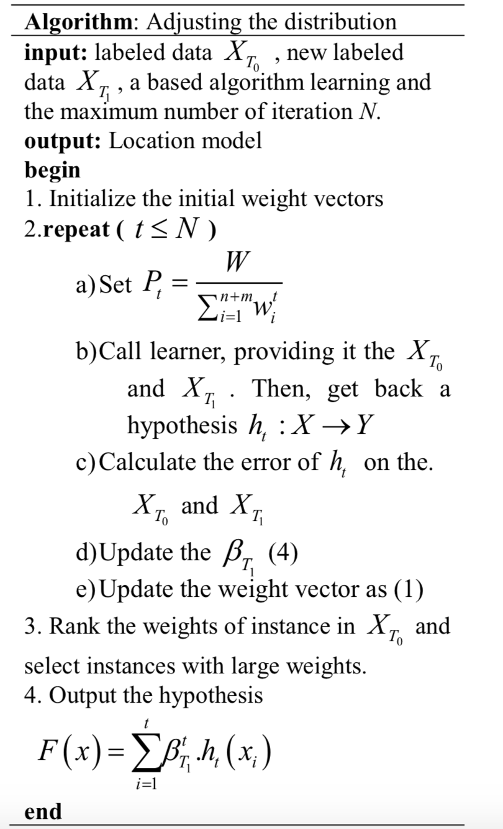
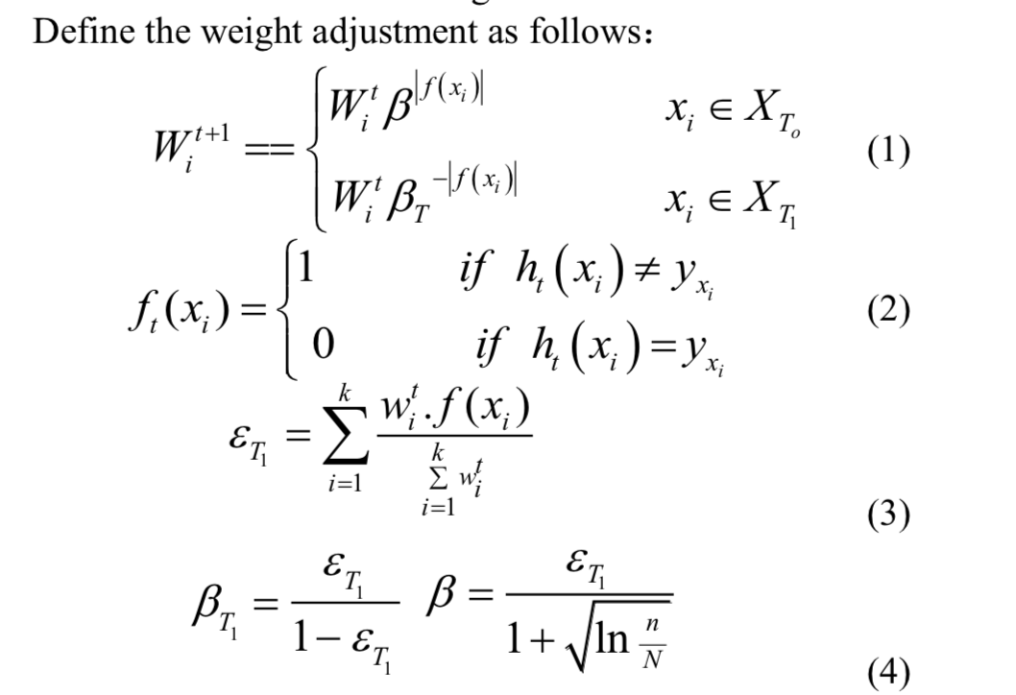
Solution

Slide 12
4
Experiment

Slide 13
Experiment
Data set
The UJIINDOORLOC divided into a training set with 19,937 fingerprints and a testing set with 1,111 fingerprints.
The testing data are performed 4 months later than when the training data gathered. Therefore, the distributions of the training data and testing data are different, and to locate these data is challenging

Slide 14
Experiment
To prove the validity of our algorithm, we do other two experiments. One uses original data to train model and use original testing data to test the model, as experiment 1.
The other uses partial testing data to train model and uses another part to test model, as experiment 2.

Slide 15
Thanks!

