Slide 1


Content-Aware Load Balancing in CDN Network
Ziqi Cui, Yongxiang Zhao*, Chunxi Li, Yunpeng Song, Wenwen Li

Slide 2
One-Minute Overview
The limited bandwidth of CDN server become a bottleneck of QoE improvement
QoE related to content of videos
Decide the bitrate and allocation policy according to characteristic of video content
Notes:
But we argue that user’s attention does NOT grow with the screen size. In fact, it is limited, so if we accurately track the user’s attention, we can dramatically cut the bandwidth need of 360 videos.
[click]
To put it in practice, we present Pano, a 360 video streaming system which lowers the quality of the contents where the user is not sensitive. Pano can reduce bandwidth need of 360 videos by 46% without hurting user experience.

Slide 3

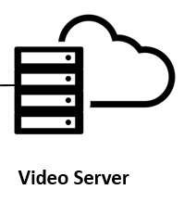
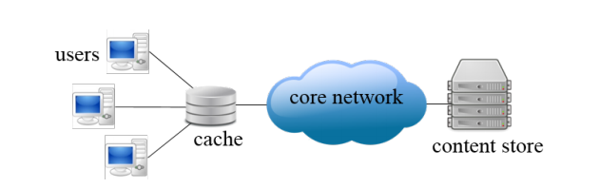

CDN overview
Core network
cache
cache

Slide 4
Conventional load balancing wisdom
Balance the load among CDN servers.
Takes video QoE into consideration.
Jointly considers traffic load and QoE to map users to proper servers

Slide 5




QoE related to content of videos
94
82
1080p
58
240p
6
Ray, J. Kosaian, K.V. Rashmi, S. Seshan., ”Vantage: Optimizing video upload for time-shifted viewing of social live streams,” SIGCOMM 19: Proceedings of the ACM Special Interest Group on Data Communication August 2019, 2019, pp. 380-393.

Slide 6
QoE related to content of videos
Different video frames require different size (i.e. bitrate) to get the same quality QoE, and the gradient of the frame size-QoE curves is also different.

Slide 7
Our approach
Calculate the QoE-bitrate relationship of different videos
Distribute the bitrate of frames that has low sensitivity to those that has high sensitivity

Slide 8
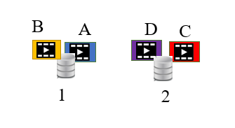


Basic idea
Case 1:
Overall QoE = 3.34
A
B
C
D
Case 2：
server1
server2
Overall QoE = 3.5
Bandwidth = 100

Slide 9
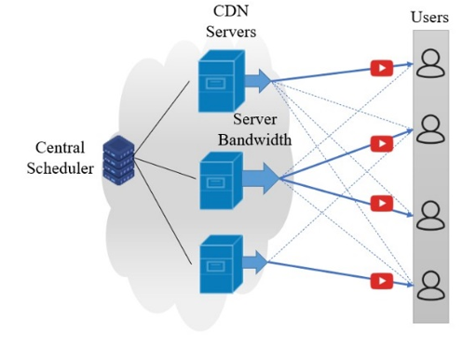
How dose it look like in a real system?
Notes:
介绍系统

Slide 10
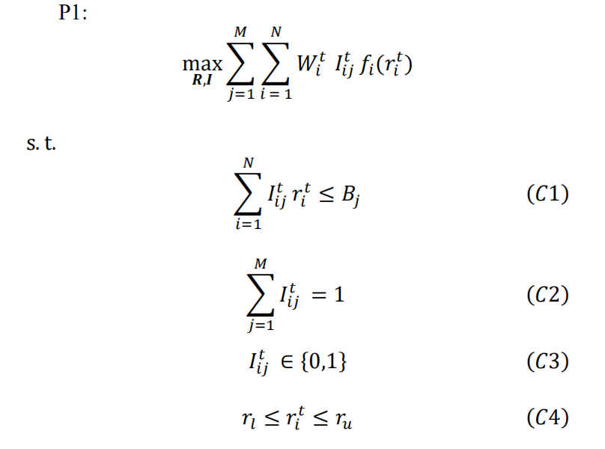
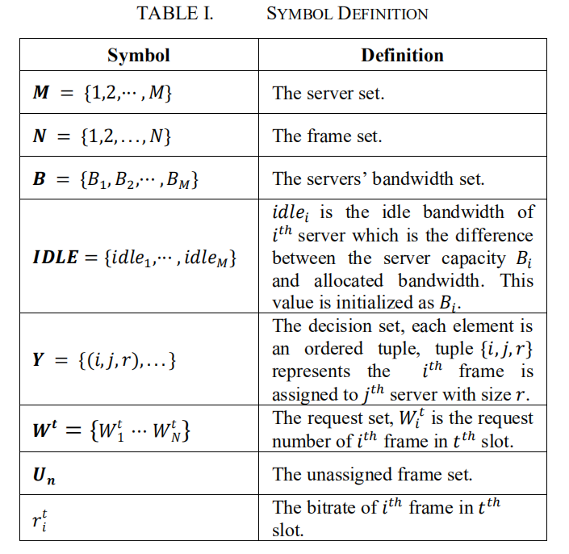
How to build the optimization model?
P1 is a mixed-integer problem hard to solve with a large number of frames and servers.
Notes:
讲优化模型

Slide 11
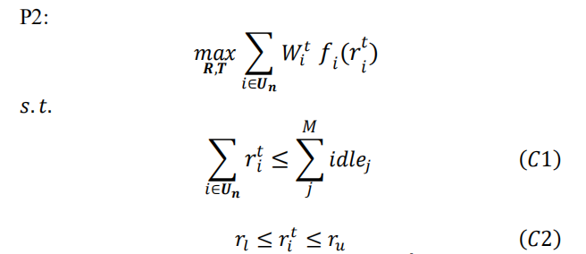

How to solve the optimization model?
Step 1: The Ideal Virtual Model
Step 2: Greedy Allocation
  Measurement of frame value
  Core ideal
    Allocate the frame with highest value to the server with the most available bandwidth.
Notes:
启发式求解

Slide 12
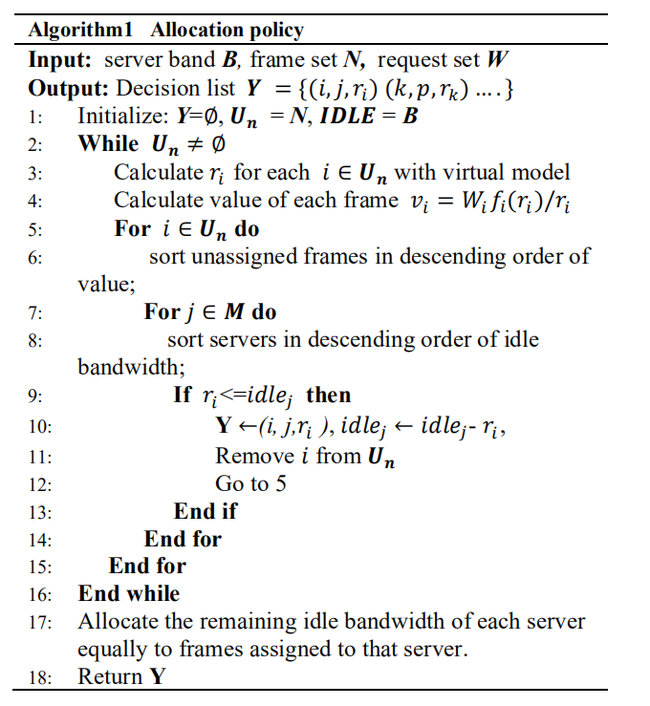
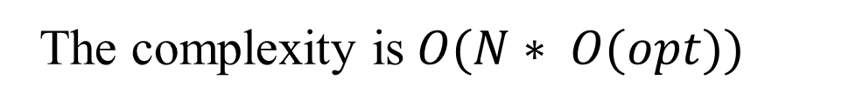
How to solve the optimization model?
The complexity is$O(N∗ O(opt))$

Slide 13

Evaluation
Datasets
  200 frame of 10 videos (720p)
Three evaluations
  Impact of Server Bandwidth
  Impact of Frame Popularity
  Impact of Server Numbers
Four baselines
  Random policy
  Evenly policy
  Popularity-aware policy
  Ideal policy

Slide 14
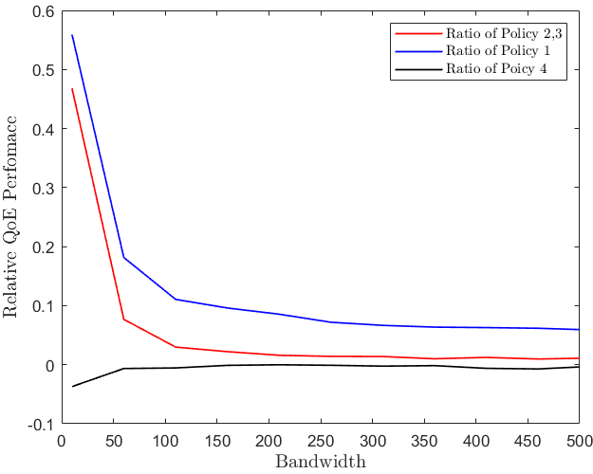
Impact of Server Bandwidth

Slide 15
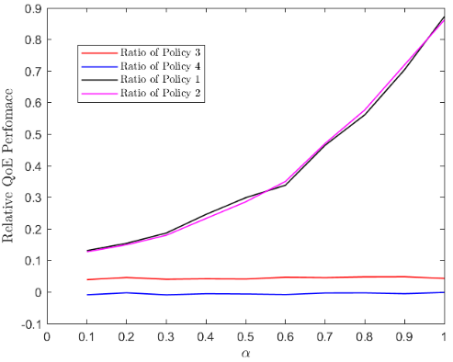
Impact of Frame Popularity

Slide 16
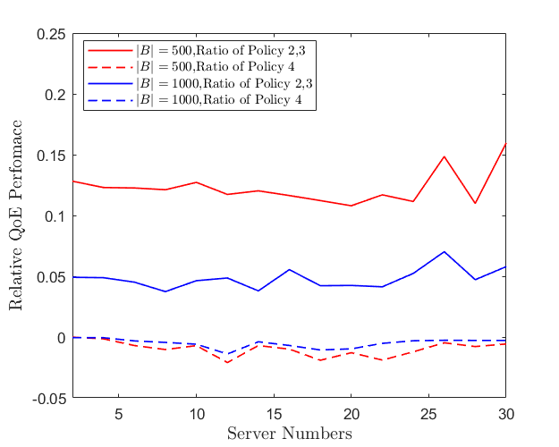
Impact of Server Numbers

Slide 17
Conclusion
Bandwidth of CDN has always been a bottleneck in service performance improvement.
Different video frames require different size (i.e. bitrate) to get the same quality QoE.
Our approach: considering the QoE-frame size relationship and schedule video request among CDN servers.
Results: improve the overall QoE by about 5% compared with the traditional method.

