Slide 1

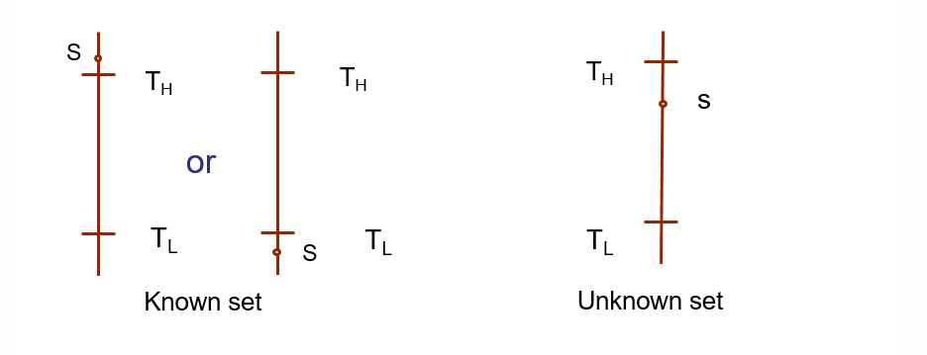
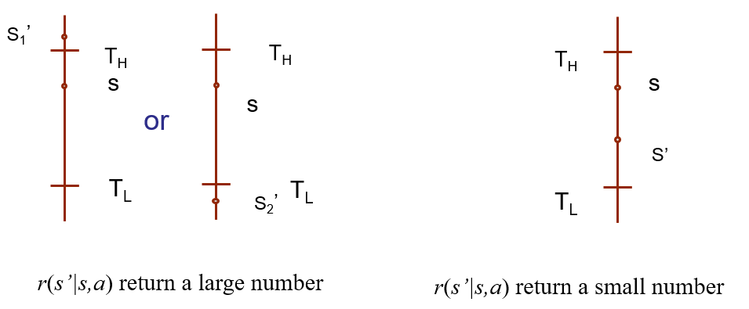
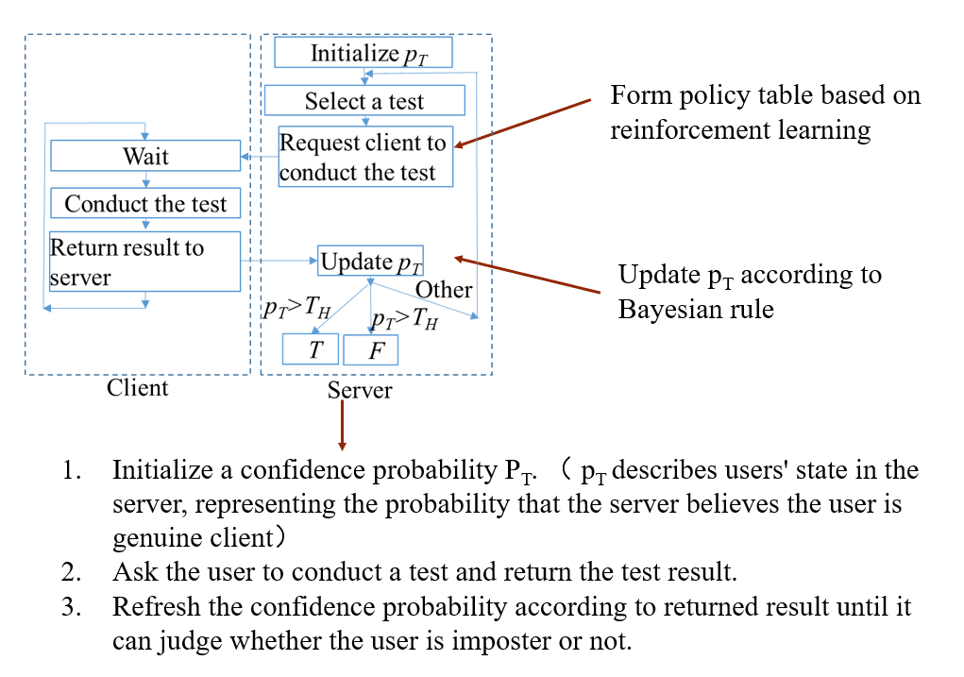
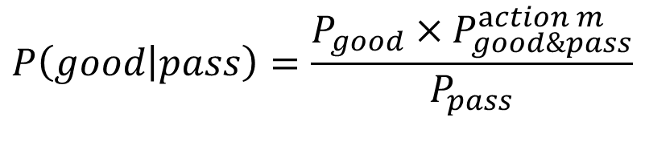
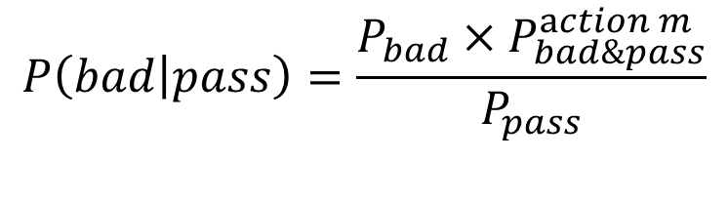
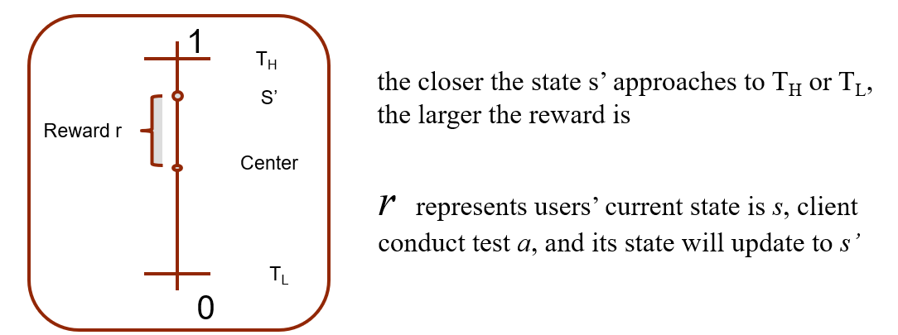
An Adaptive Authentication Based on Reinforcement Learning
Ziqi Cui¹, Yongxiang Zhao¹, Chunxi Li¹, Qi Zuo², Haipeng Zhang² 1. Information and electronic school, Beijing Jiaotong University 2. Beijing Cloud Computing Key Technique and Application Key Laboratory, Beijing Computing Center
INTRODUCTION
Furthermore, we name the states set {s|s>T_{H} or s<T_{L}} and {s|T_{L}<=s<=T_{H}} as known set and unknown set respectively. We add an extra condition in reward function to increase the importance of s which belongs to the known set: if both s and s' belongs to the known set, r(s'|s,a) will return with a large number; if s belongs to the known set while s’ does not, r(s'|s,a) will return with a rather small number. By this way, the state in the known set gains more importance and algorithm will prefer to select the test to enter known set quickly.
Fig.3 Known set & Unknown set
Another input parameter in reinforcement learning is p(s’|s,a), which represents the probability that state s transfers into state s' by taking action a. First, given a state s and an action a, and assuming the test result, we can find the value p_{T} that will transfer and its corresponding transferring probability by Bayesian formula above.
Money transfer applications like Alipay and Wechat are widely used in daily life nowadays. The major concern of such online money transfer applications is to authenticate the user of the applications. Different authentication confidence probabilities are required when doing different amount of online commercial transfer. We should select authentication method according to the requirement of confidence probability and the prior knowledge of users and spend less authentication time as much as possible.
ADAPTIVE MULTI-FACTOR AUTHENTICATION
A. Application scenario
We assume there are N sequentially numbered Mono-factor tests. We use symbol p^{m}_{ij} to represent an outcome probability, meaning that we use test m for user type i to get an output j (pass or not pass the test). We denote authentication time of test m as C_{m}. Both p^{m}_{ij} and C_{m} are m^{th} statistical data known by the server.
Fig.1 System and flow chart
B. Bayesian updating
When the server gets a result from client, then we have following equations to update P_{T} according to Bayes formula:
By this way, If the user pass the test, the probability that the user is legal will rise, otherwise, it will decrease. If the test is failed, we can update P_{T} in the same way.
C. Creating Policy Table
We will use reinforcement learning to create policy table. First, we define the state s in reinforcement learning as the value of p_{T} and action set at each state is set of tests. Then we define reward function as follows:
r(s’|s,a)=|s'-(T_{H} -T_{L})/2|.
r(s’|s,a) represents reward obtained when following events happen: users’ current state is s, client conduct test a, and its state will update to s' . By this function, the closer the state s' approaches to T_{H} or T_{L}, the larger the reward is.
Fig.2 Reward function
NUMERICAL RESULTS
A. Baseline schemes
We use two baseline schemes to compare with our scheme. Both schemes are the same with our scheme shown in Fig.1 except that they use different method to choose test
1) Chooses a test randomly
2) Fixes to one test and output the smallest average cost of all the tests’
We use following metrics to evaluate the performance authentication progress:
1) False positive :the probability that a F user is authenticated as a T user
2) True positive: the probability that T user is authenticated as a T user
3) Average cost: average cost to authenticate a user.
B. Experiments setting
The following table shows the setting of five types of test:
Table 1 Parameters settings of tests
We have 100,000 users to be tested, and 60% of users belong to T and the rest belong to F. T_{H} and T_{L} are set to be 0.95 and 0.05 respectively.
C. Test results
Simulation results are shown in Table 2:
Table 2 Simulation results
As is shown above, our scheme can save about 54% and 15% cost than baseline 1 and baseline 2 respectively while obtaining required confidence probability. We have also tried other tests' parameter settings and found that average cost of our scheme is always no more than the average cost of either baseline 1 and 2.
Test type | p^{m}_{TS} | p^{m}_{FS} | C_{m}
1 | 0.3 | 0.2 | 100
2 | 0.35 | 0.3 | 250
3 | 0.55 | 0.45 | 400
4 | 0.75 | 0.60 | 550
5 | 0.90 | 0.1 | 1000
Schemes | false positive | true positive | average cost
Baseline 1 | 0.0415 | 0.9747 | 4509.8
Baseline 2 | 0.011 | 0.9716 | 2437.5
Our scheme | 0.011 | 0.9886 | 2060.8

