Slide 1
Characterizing Social Marketing Behavior of E-commerce Celebrities and Predicting Their Value
Authors: Xiang Li, Yuchun Guo, Ye Sheng, Yishuai Chen
Institution: School of Electronic and Information Engineering, Beijing Jiaotong University
Email: 18120100@bjtu.edu.cn

Slide 2
01
Introduction
CONTENTS
02
Behavior Analysis
03
Experiment
04
Conclusion

Slide 3
01
Introduction

Slide 4
01 Abstract
(1)
E-commerce
Celebrities(ECs)
(2)
Characterize
Marketing behavior
Nonmarketing behavior
41 features
Predict an EC’s sale volume
marketing activities
business activities
social network platforms
e-commerce platforms

Slide 5
01 Abstract
(3)
Cross-platform
measurements
Choose representative ECs
Taobao and Weibo
About 450,000 EC microblog data on Weibo from 2010 to 2018
sale data on Taobao in April 2018

Slide 6
02
Behavior Analysis

Slide 7
02 Behavior Analysis
Marketing behavior
New product behavior
Lottery behavior
Word-of-mouth behavior
Nonmarketing behavior
Daily behavior
Personal information

Slide 8
02 Behavior Analysis
Content | Translation
12.12 我来啦！ 这个月很多高级的东东, 我的女王殿下们。 转抽 3 个 BB 送， 喜欢哪款大声告诉我， 都是高级货抽中了好划算啊 . . . | 12.12 here I come! There are many awesome goods this month, my queen. I will pick 3 babies from those who repost this microblog for a gift, and tell me aloud which one you like best. It’s a good deal because it is a premium product. . .
留言送出一整套 look！ 这次新品里我超愛的一個 牛仔背心很酷, 很街頭俏皮的短裙 也可以混搭的很有型, 穿上那一刻覺得自己 . . . 又帥了! | I will choose one person from the those who comment this microblog ant send out a set of the clothes! A cowboy vest I love in this new products is cool, and the street-playful skirts can also be matched. The moment I put on the clothes, I felt. . . handsome again!
lottery behavior
new product
behavior

Slide 9
02 Behavior Analysis
New product
behavior
Word-of-mouth
behavior
Lottery behavior
Other features
Promotional activities
Cyclical
Reposting
Giving-a-like
Commenting
Secondary diffusion
Buyer Show
Increase the stickiness of existing followers
New product behavior | Lottery behavior | Word-of-mouth behavior | Other features
#New product posts/ month | #Reposting lottery/ month | #Followers(lv1-lv5) | #Reposts/ marketing blog
#Reposts/ new product blog | #Commenting lottery/ month | #Follows(lv1-lv4) | #Comments/ marketing blog
#Comments/ new product blog | #Giving-a-like lottery/ month | #Posts(lv1-lv4) | #Likes/ marketing blog
#Likes/ new product blog |  | #Interaction(lv1-lv5)[1] | #Reposts/ month
 |  | #Overlap(lv1-lv5)[2] | #Giving likes/ month
[1]#Interaction: The number that a user is liked or reposted by an EC
[2]#Overlap: The number of ECs who have interacted with the follower

Slide 10
02 Behavior Analysis
Nonmarketing
behavior
Daily behavior
Personal information
Nonmarketing behavior
#Daily posts/ month
#Reposts/ daily blog
#Comments/ daily blog
#Likes/ daily blog
#Followers/ EC
#Follows/ EC

Slide 11
03
Experiment

Slide 12
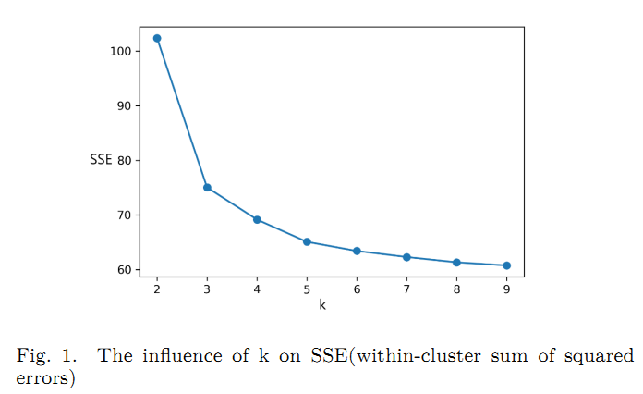
03 Experiment
(1)
Experimental Setup
Three levels
High: [mean + 0.5*std, +∞)
Medium: [mean - 0.5*std, mean + 0.5*std)
Low: [-∞, mean - 0.5*std)
Comparative experiments
Full-time Nonmarketing Behavior Model(FNBM)
Full-time Marketing Behavior Model (FMBM)
Full-time Full-feature Model (FFM)
Full-feature Model in the past three years (FM3)
Full-feature Model in the last year (FM1)
 | FNBM | FMBN | FFM | FM3 | FM1
LR | 0.53 | 0.59 | 0.64 | 0.65 | 0.68
kNN | 0.61 | 0.61 | 0.69 | 0.74 | 0.78
RF | 0.61 | 0.60 | 0.77 | 0.81 | 0.83

Slide 13
03 Experiment
(2)
Top-10 Most
Important Features
High interaction level have the strongest impact on sales
Repost-based lottery: increase the reach of blogs
Cheating component: “Zombie”accounts in the Followers
Likes: simple, without any pop-ups and page jumps
Medium #Overlap and #Followers scale contribute more to sales
The ability to interact with active followers is critical
Features | Importance
Interaction-lv5 | 6.43%
#Reposts/ marketing blog | 6.29%
#Followers/ EC | 5.87%
#Likes/ daily blogs | 5.81%
Interaction-lv4 | 4.65%
Overlap-lv3 | 4.39%
Followers-lv2 | 4.21%
#New product posts/ month | 3.97%
#Comments/ marketing blog | 3.72%
#Reposting lottery/ month | 3.51%
Sum: 48.85%

Slide 14
04
Conclusion

Slide 15
04 Conclusion
the first cross-platform measurement of ECs
41 features
Top-10 important features
Help ECs optimize their strategies
Limitation and future work
The size of data
Multiple types of platforms
Selling products through online live

Slide 16
THANK YOU!

