Slide 1
Cross-Platform Measurement
on Ad Exchanges
Chenyue Zhang¹, Chunxi Li¹, Yongxiang Zhao¹, Nanxi Huang¹, Baoxian Zhang²
1. School of Electronic and Information Engineering, Beijing Jiaotong University
2. University of Chinese Academy of Sciences

Slide 2
Outline
Introduction
Parallel Cross-Platform Measurement Method
Performance Evaluation
Conclusion

Slide 3
Outline
Introduction
Parallel Cross-Platform Measurement Method
Performance Evaluation
Conclusion

Slide 4
Introduction
Ad request
Visit
Cooperate
ADX
Ad response
Users
Publisher
Advertiser
Ad system with single ADX
Ad exchange platform (ADX) is a key component.
A large amount of ADXs exist in real ad network.
Evaluation between different ADXs is crucial.

Slide 5
Introduction
ADX1
Visit
Ad request
ADX2
How to choose?
Ad response
Users
Publisher
Advertiser
ADX3
Cross-platform measurement scenarios
Cross-ADX-platform research need to let the multiple ADXs acquire the same user information.

Slide 6
Outline
Introduction
Parallel Cross-Platform Measurement Method
Performance Evaluation
Conclusion

Slide 7
Parallel Cross-Platform Measurement Method
Find intersection pages
OpenWPM (an automated web privacy measurement platform developed by Princeton)
http requests, http responses, and third-parts’ embedded links
Webpages
monitored
by ADX1
Webpages
monitored
by ADX2
Webpages jointly monitored
by both ADX1 and ADX2
(Intersection pages)

Slide 8
Parallel Cross-Platform Measurement Method
Generate training page sets
Perform word segmentation after removing non-Chinese characters.
Use TF-IDF to get the top 20 feature words to represent the page.
Use k-means to classify the intersection pages into different clusters as training-page sets.
According to Google AdWords, link each cluster to an ad category closest to it and use the ad category name as the cluster's tag.

Slide 9
Parallel Cross-Platform Measurement Method
Train virtual role and Extract ads
Training page set with certain tag
Typical portal pages without obvious interest bias
Typical portal pages
Training pages
Webpages visited by virtual role

Slide 10
Parallel Cross-Platform Measurement Method
Mine ad keywords
Text HTML file
Extract keywords from the title or the product description

Slide 11
Parallel Cross-Platform Measurement Method
Mine ad keywords
Ad image
Use Google Image Search Engine to help parse image and get keywords
Google image recognition

Slide 12
Parallel Cross-Platform Measurement Method
Mine ad keywords
Landing page's URL
Send the URL to Google AdWords keyword planner to get keywords

Slide 13
Outline
Introduction
Parallel Cross-Platform Measurement Method
Performance Evaluation
Conclusion

Slide 14
Performance Evaluation
Datasets and key performance indicators
We measured Google and Baidu ADXs in Jan. 2018 for evaluating our method.
Two key performance indicators (KPIs) *
Targeted Training Keywords (TTK)
TTK value T_{i} represents the training page keywords displayed on the landing page as a percentage of the total training page keywords.
Behavioural Advertising in Landing Pages (BAiLP)
BAiLP value B_{i} reflects the percentage of targeted ads in all the ads received by a virtual role i.
* Proposed in I Always Feel Like Somebody's Watching Me: Measuring Online Behavioural Advertising

Slide 15
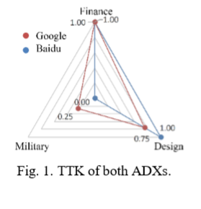
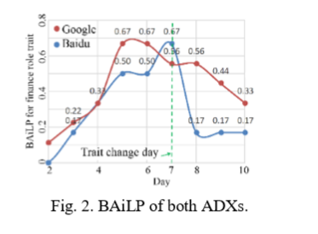
Performance Evaluation
Numerical results
Static behavior of ads targeting
Dynamic behavior of ads targeting

Slide 16
Outline
Introduction
Parallel Cross-Platform Measurement Method
Performance Evaluation
Conclusion

Slide 17
Conclusion
Cross-Platform Measurement on Ad Exchanges
Find intersection pages
Generate training page sets
Train virtual role and Extract ads
Mine ad keywords

Slide 18
Cross-Platform Measurement
on Ad Exchanges
Chenyue Zhang, Chunxi Li, Yongxiang Zhao, Nanxi Huang, Baoxian Zhang
Thanks for your listening!

